Slide 1
Capstone Engagement
Assessment, Analysis, and Hardening of a Vulnerable System

Slide 2
Table of Contents
This document contains the following sections:
01
Network Topology
02
Red Team: Security Assessment
03
Blue Team: Log Analysis and Attack Characterization
Hardening: Proposed Alarms and Mitigation Strategies
04

Slide 3
Network Topology
3

Slide 4
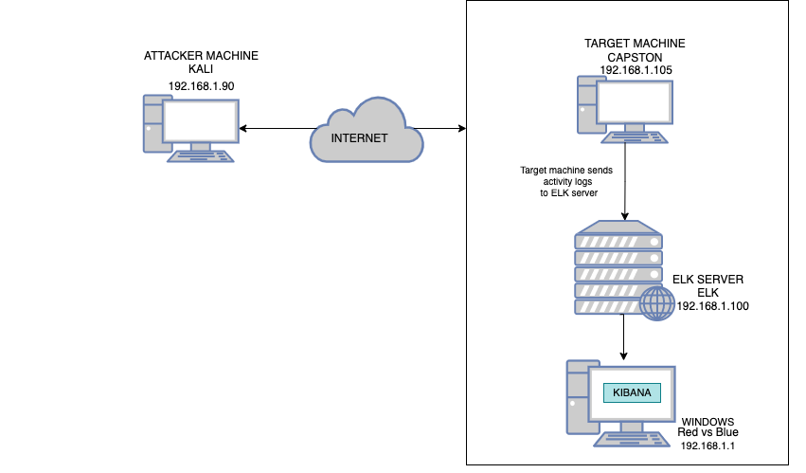
Network Topology
Network
Address Range: 192.168.1.0/24
Netmask: 255.255.255.0 Gateway: 192.168.1.1
Machines
IPv4: 192.168.1.90
OS: Linux 2.6.32
Hostname: kali
IPv4: 192.168.1.105
OS: Linux Hostname: Capstone
IPv4: 192.168.0.100
OS: Linux
Hostname: ELK
IPv4: 192.168.1.1
OS: Windows
Hostname: Red vs Blue - ML-REFVM

Slide 5

Red Team
Security Assessment
5

Slide 6
Recon: Describing the Target
Nmap identified the following hosts on the network:
Hostname | IP Address | Role on Network
Red vs Blue ML-REFVM | 192.168.1.1 | Virtual Host machine for the project. Where we will view data.
Elk | 192.168.1.100 | Logs activity data from Capston machine and runs the analytics associated with Kibana
Capstone | 192.168.1.105 | Target machine
Kali | 192.168.1.90 | Predator Machine

Slide 7
Vulnerability Assessment
The assessment uncovered the following critical vulnerabilities in the target:
Vulnerability | Description | Impact
Open port 80 | Open ports can allow attackers to access private information and increase the risk of a data breach. | This allowed the red team to find private directory with accessible files.
HTTP Requesting Hidden Directories | Unprotected secret files that can be accessed through HTTP requests | This allowed the red team to Gain access to sensitive files
Brute Force Attack | Attacking the server with multiply pings against a word list that allows the password to be discovered quickly | his allowed the red team to brute force Ashton’s password, which was Leopoldo, and access the secret files in the system.
Reverse Shell/Meterpreter Exploit | Allows upload access to a webserver that’s running PHP | Allows a hacker to upload malicious files that can be used to exploit a server for sensitive information

Slide 8
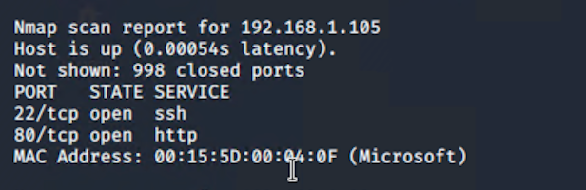
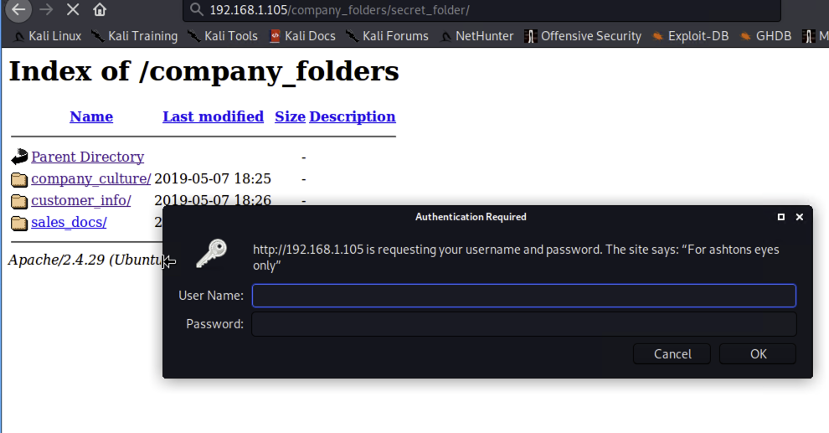
Exploitation: Open por 80 - HTTP Requesting Hidden Directories
01
03
Tools & Processes
Nmap: to find the IP address fo the Linux server
02
Achievements
Able to access the server and find the hidden directories.
The hidden directory gave me a valid username to sign onto the secret directory

Slide 9
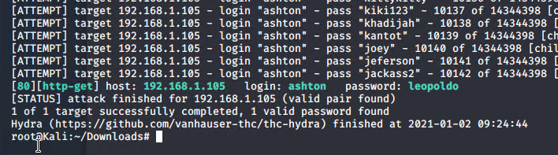
Exploitation: Brute Force Attack
01
02
Achievements
By combining hydra and the rock you.txt file I was able to find the paasword for the use ashton.
Tools & Processes
Hydra and rockyou.txt word list
03

Slide 10
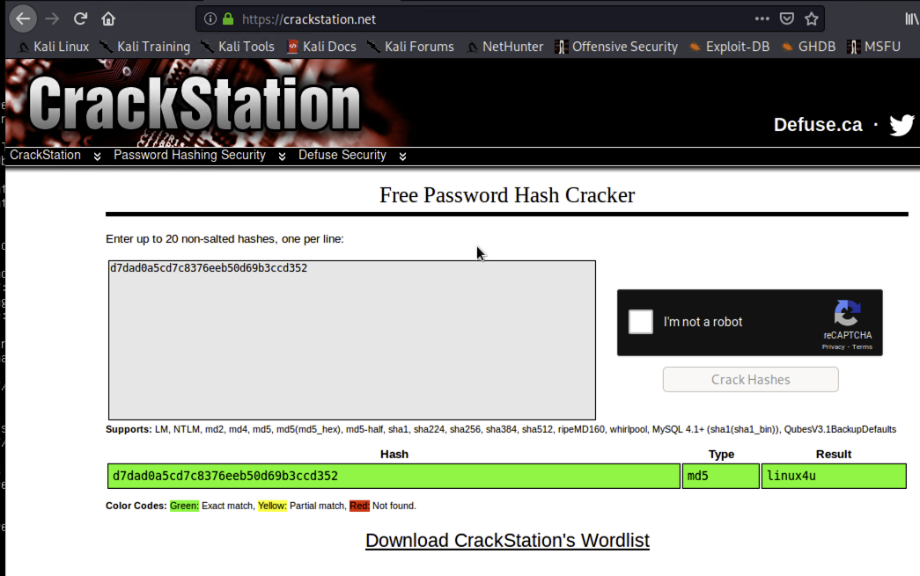
Exploitation: Hashed Password
01
03
Tools & Processes
We used the website Crackstation.net to find the plaintext of the hashed password for Ryan
02
Achievements
This password granted us access to the system through the WebDav connection, which later allowed us to upload a shell script to attack.

Slide 11
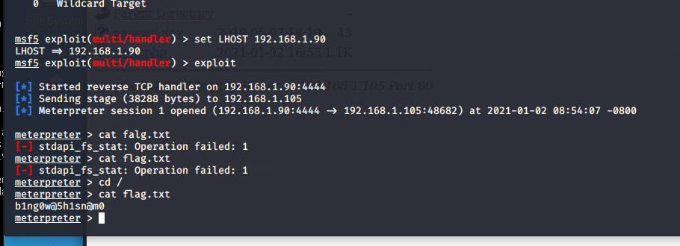
Exploitation: Reverse Shell/Meterpreter Exploit
01
02
Achievements
Able to upload a reverse shell onto the webDAV directory
After running the shell, I was able to capture the flag
Tools & Processes
Meterpreter & msfconsole
03

Slide 12

Blue Team
Log Analysis and Attack Characterization
12

Slide 13

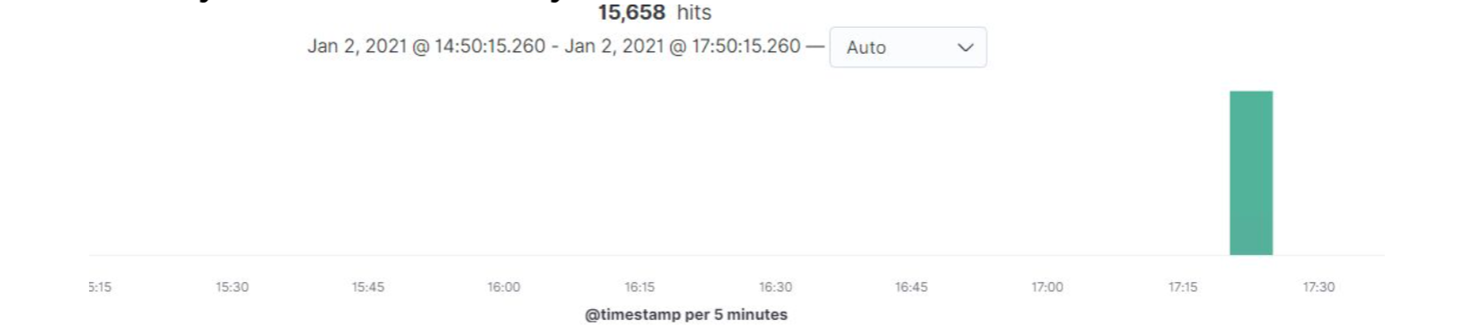
Analysis: Identifying the Port Scan
The port scan began around 5:20 pm
15,658 hits were sent from 192.168.1.90
The nmap ping requests to the 443 port, so filtering that, we saw the results bellow
.

Slide 14
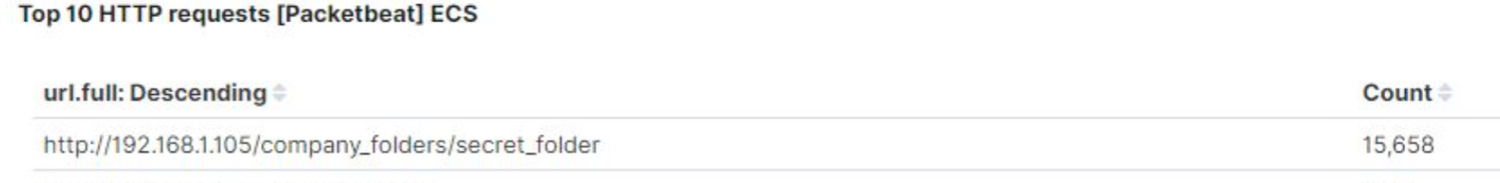
Analysis: Finding the Request for the Hidden Directory
15,658 requests for the hidden directory occurred Dec -20-20 at 1am.
● The file requested was a secret folder hidden within the company folders.
● The secret folder contained instructions on how to access the webdav server using Ryan’s account. It also included a hashed password.

Slide 15
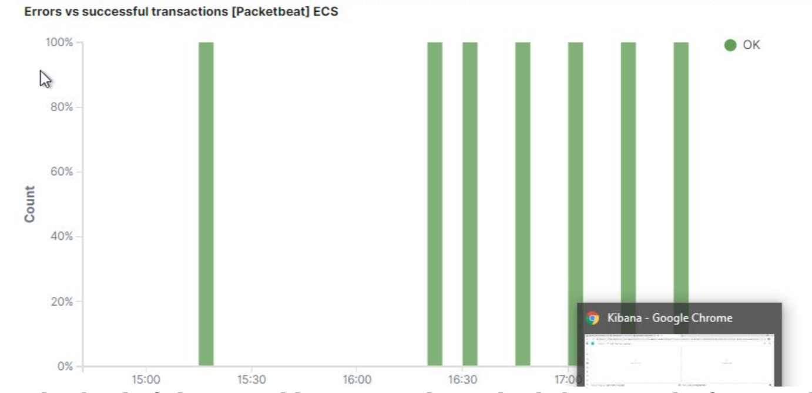
Analysis: Uncovering the Brute Force Attack
15,658 request were made in the brute force attack
Out of 15,198 requests, only 7 were successful discovering the password

Slide 16
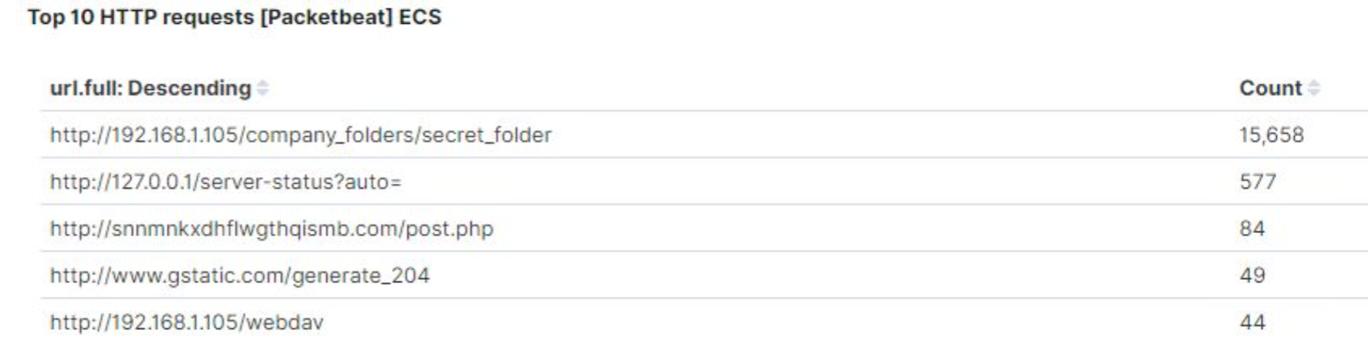
Analysis: Finding the WebDAV Connection
44 requests were made to the WebDav directory
The shell.php file was requested. This was a part of the red team’s shell attack to start listening for activity on the victims machine.

Slide 17
Blue Team
Proposed Alarms and Mitigation Strategies
17

Slide 18
Mitigation: Blocking the Port Scan
We will set up an alarm for when a firewall detects more than 10 port scans in a minute or 100 consecutive (ICMP) requests.
Most firewalls and IPSs can detect such scanning and cut it off in real time.
Enable only the traffic you need to access internal hosts and deny everything else.
This goes for standard ports, such as TCP 80 for HTTP and ICMP for ping requests.

Slide 19
Mitigation: Finding the Request for the Hidden Directory
Remove the directory and file from the server.
Terminal:
rm -r ../company_files → to remove directory
If needed, move the directory to a safer or offline location.
We will set an alert that goes off for any machine that attempts to access this directory or file.
The threshold will be more than 1 attempt.

Slide 20
Mitigation: Preventing Brute Force Attacks
We will set an alert if ‘401 Unauthorized’ is returned from any server to hat would weed out forgotten passwords. Start with 10 attempts in one hour and refine from there.
We will also create an alert if the `user_agent.original` value includes `Hydra` in the name.
After the limit of 10 ‘401 Unauthorized’ codes have been returned from a server, that server can automatically drop traffic from the offending IP address for a period of 1 hour.
We could also display a lockout message and lock the page from login for a temporary period of time from that user.

Slide 21
Mitigation: Detecting the WebDAV Connection
We can create an alarm that fires every time this directory is accessed.
The threshold would be unlimited so that we are notified everytime the directory is accessed.
Restricting access with firewall rules and removing web access to the server.
Connections to this shared folder should not be accessible from the web interface.
Connections to this shared folder could be restricted by machine with a firewall rule

Slide 22
Mitigation: Identifying Reverse Shell Uploads
We can set an alert for any PHP moving across the open port 4444
The threshold will be to pinpoint any .PHP
The windows host file can be edited to deny the ability to upload.

